Slide 1
数据 演绎 价值
海捷-BIEE培训

Slide 2
目录
第一部分
OBIEE产品介绍
第二部分
报表开发
第三部分
Publisher
第四部分
其他功能

Slide 3
目录
第一部分
OBIEE产品介绍

Slide 4
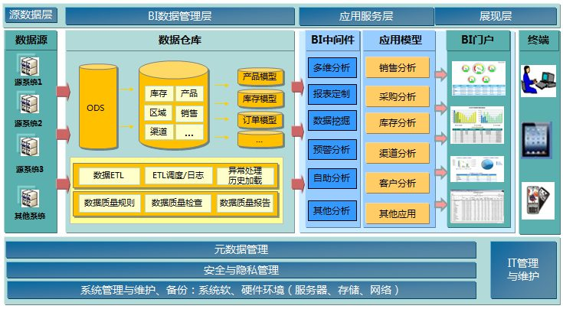
BI系统架构
BIEE11g

Slide 5

























Oracle Business Intelligence 11g
与办公应用
集成
与办公应用
集成
移动
工具
绩效
记分卡
移动
工具
绩效
记分卡
交互式
仪表盘
交互式
仪表盘
报表和
发布器
数据
整合
报表和
发布器
数据
整合
检测
警报
Ad-hoc
分析
检测
警报
即席
分析
协作
搜索
协作
嵌入
搜索
嵌入
通用企业信息模型
跨所有数据源的通用的元数据基础
通用的安全机制、访问控制、认证、审计追踪等
通用的查询生成，优化数据访问服务
通用的集群、负载管理及部署
通用的系统及运营生命周期管理
OLTP & ODS
系统
数据仓库
数据集市
Exadata
OLAP
数据源
成套
应用软件
(Oracle, SAP, Others)
非结构化 &
半结构化
Excel
XML/Office
业务
流程
版权 © 2012归 Oracle和所有。 5

Slide 6
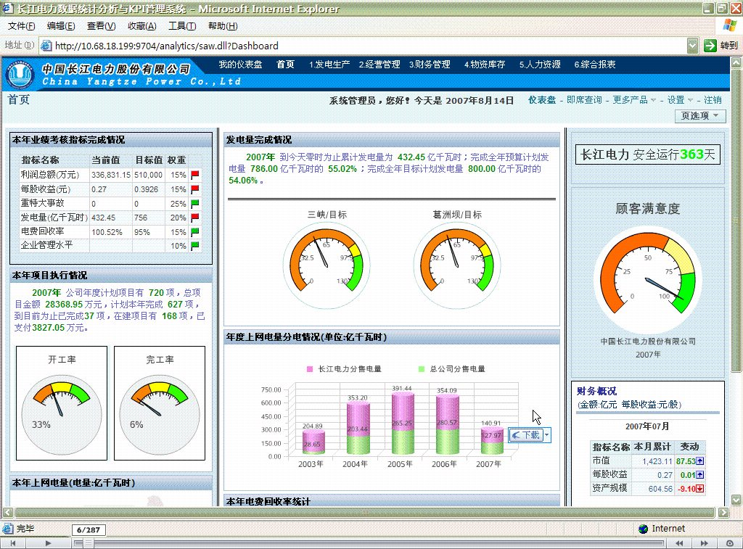
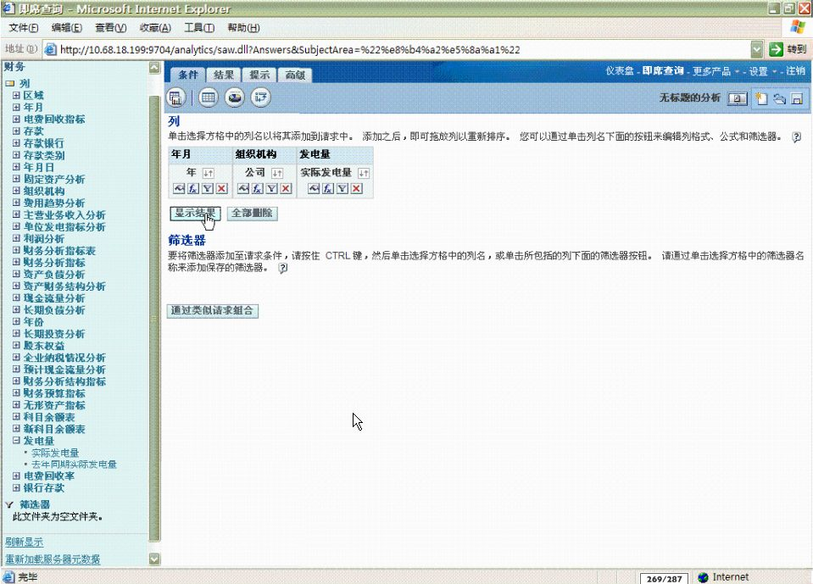
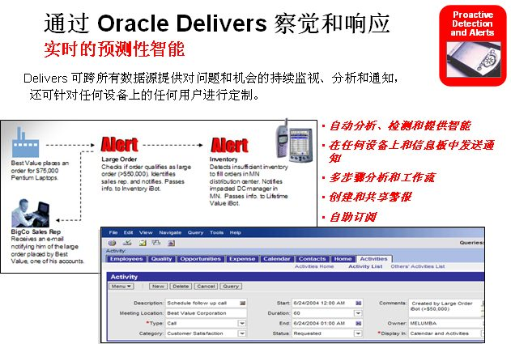
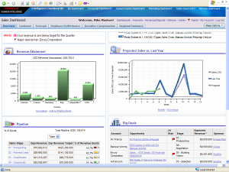
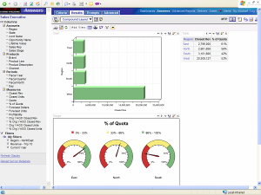


完善的洞察传递功能
旨在普及智能
Oracle 交互式信息板
生动、直观、个性化的信息板
强大的信息板到信息板导航，以及动态、事件驱动的指导性分析
针对所有人的简单但强大的智能
完全通过 Web UI 进行强大的即席分析
创建和修改图表、数据透视表和信息板
真正的业务用户可通过直观、简化的业务模型自给自足
Oracle Answers
Oracle Delivers
自动检测和警报以实现预先洞察
将内容以多种格式发送给任何设备
多步骤分析和分析工作流
Notes:
These are the primary end user products that are available with enterprise edition:
Interactive Dashboards provides any knowledge worker with intuitive, interactive access to information that is actionable and dynamically personalized based on the individual's role and identity. In the Oracle BI Dashboard environment, the end user is working with live reports, prompts, charts, tables, pivot tables, graphics, and tickers in a pure Web architecture. The user has full capability for drilling, navigating, modifying, and interacting with these results. Oracle BI Dashboard can also aggregate content from a wide variety of other sources, including the Internet, shared file servers, and document repositories
Answers provides true end user ad hoc capabilities in a pure Web architecture. Users interact with a logical view of the information—completely hidden from data structure complexity while simultaneously preventing runaway queries—and can easily create charts, pivot tables, reports, and visually appealing dashboards, all of which are fully interactive and drillable and can be saved, shared, modified, formatted, or embedded in the user's personalized Oracle BI Dashboard. The results are new levels of business user self-sufficiency in an environment that is fully secure and controlled by IT.
Delivers is a proactive intelligence solution that provides business activity monitoring and alerting that can reach users via multiple channels such as email, dashboards, and mobile devices. Oracle BI Delivers includes a full Web-based self-service alert creation and subscription portal. This next-generation product can initiate and pass contextual information to other alerts to execute a multi-step, multi-person, and multi-application analytical workflow. Furthermore, it can dynamically determine recipients and personalize content to reach the right users at the right time with the right information.

Slide 7
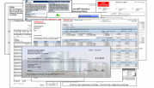
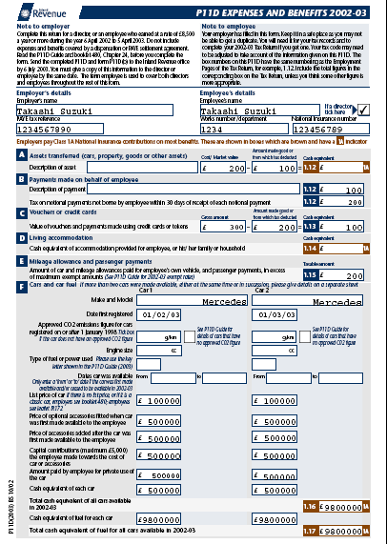
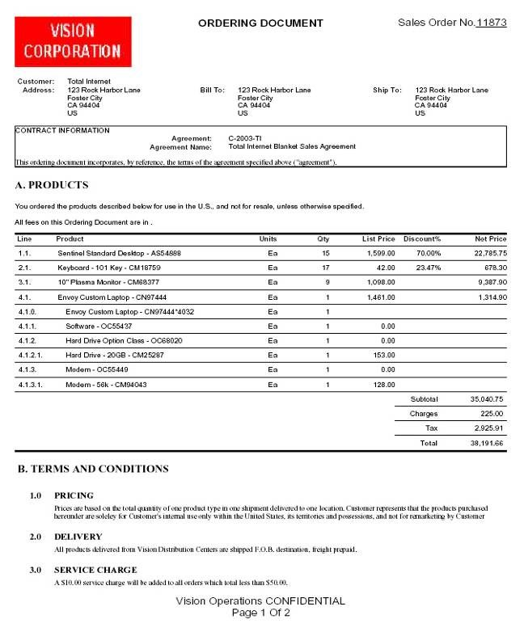
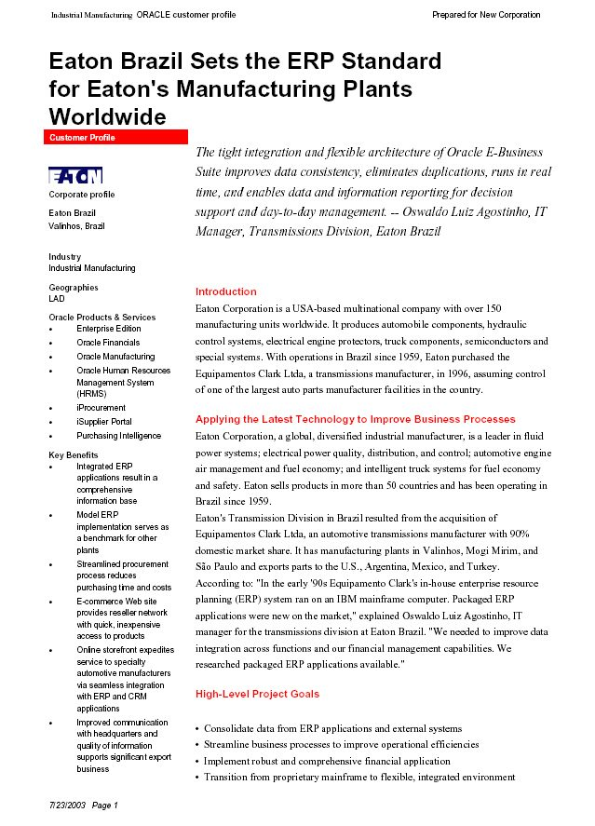
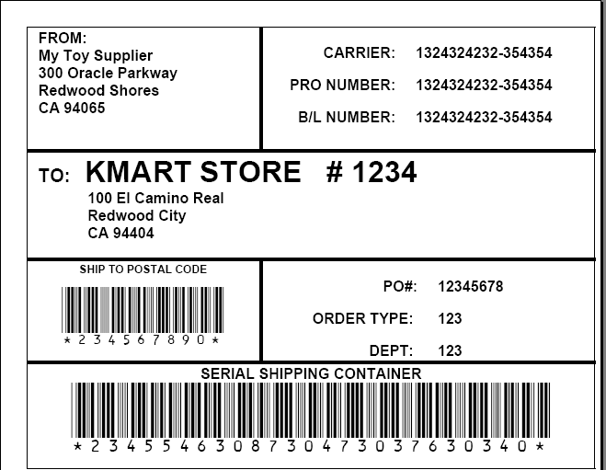
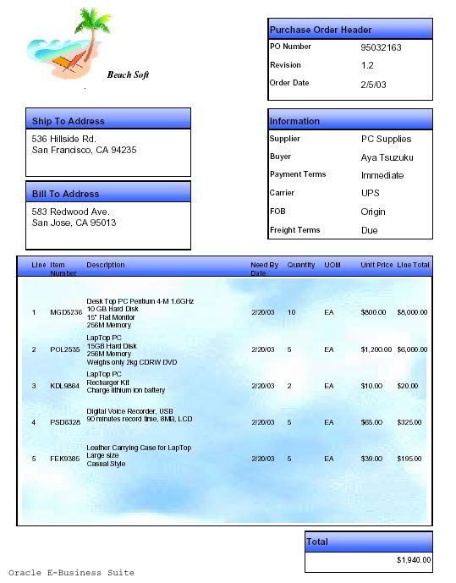
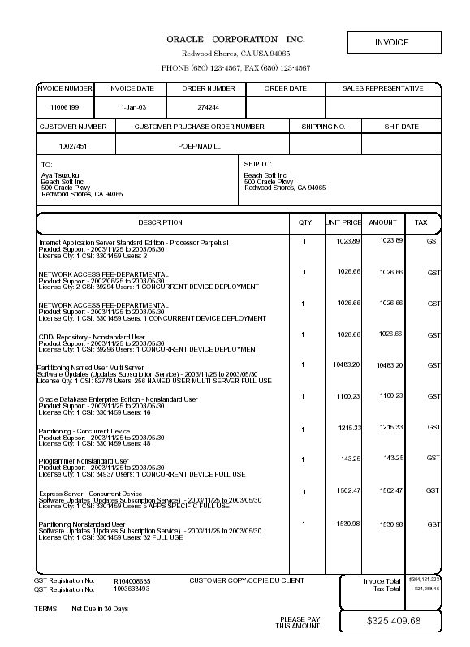
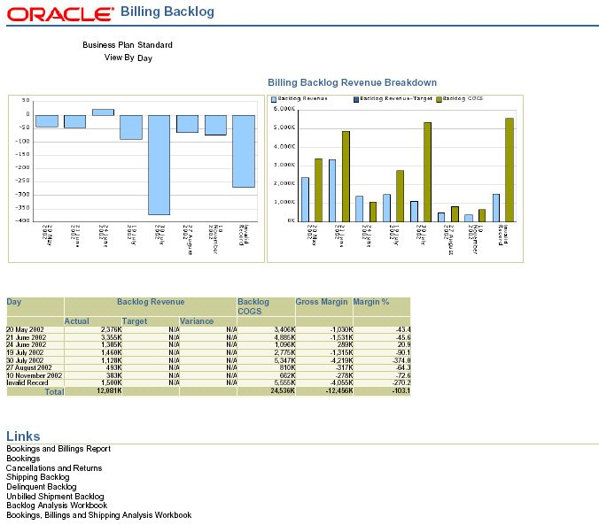
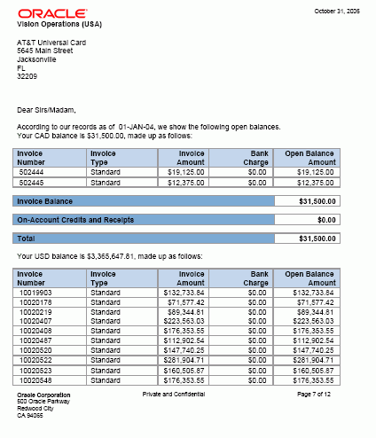
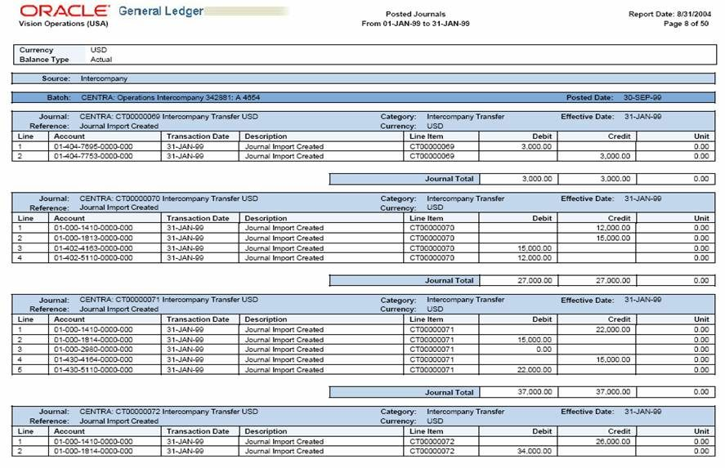
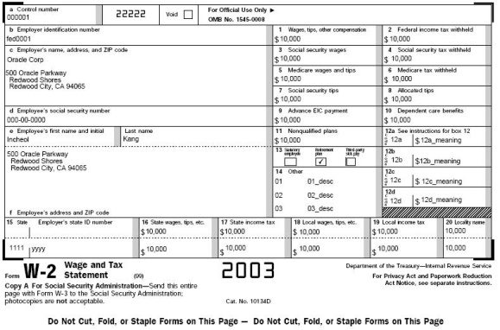
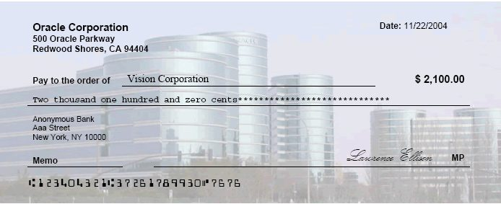
完善的洞察传递功能
旨在普及智能
真正的“点对点”报告和发布
使用熟悉工具（如 Word、Adobe）的报表布局
单一产品可满足所有文档需求 — 发票、支票、财务报表、政府表单等
Oracle BI Publisher
Notes:
7
Many customers today have very strong business requirements in the reporting area around the e-Business Suite. These include:
High Fidelity Reports:
These reports are rich in images, charts, multiple fonts and color are a very desirable feature for reports when they are to be distributed in and outside the company.
Partner Reports
These include Invoices, Purchase Orders and Checks, which require ‘rich’ content and are currently highly customized.
Financial Statements
Financial statements need to be presented to shareholders and upper management in a high fidelity format; your accounts would rather see them in Microsoft Excel.
Government Forms
Many government agencies now demand that you interact with them in a specific format e.g. tax forms.
Marketing Materials
The marketing materials generated by companies require rich personalized content.
Contracts
Interacting with your customers and suppliers often requires written contracts that need to be presented in a high fidelity format.
Checks
The checks you send to employees and suppliers require a specific format and even ink so that their banks are able to process them.
Labels
Any company generating product will need to label it often including a barcode.
XML
B2B interaction requires XML as the format and this may require a transformation of one xml format to another.
EFT/EDI
Electronic File Transfer (EFT) and (EDI) are formats used to communicate with your banks and partners.
Multiple Destinations
Of course all of these documents then need to be delivered to a report consumer be that via email, fax or printer.

Slide 8
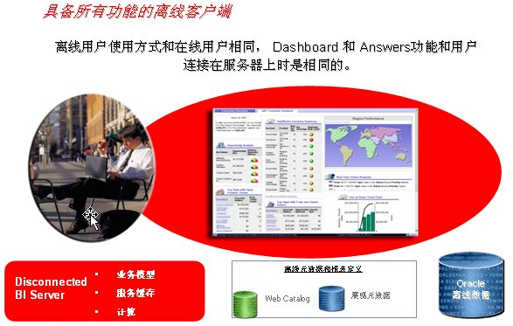
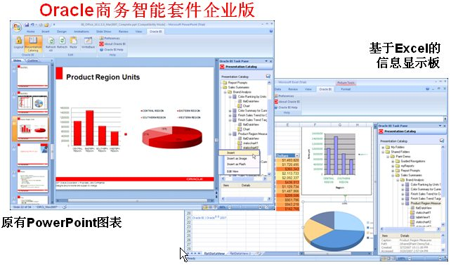

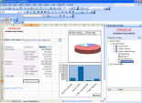
完善的洞察传递功能
旨在普及智能
真正的“点对点”报告和发布
使用熟悉工具（如 Word、Adobe）的报表布局
单一产品可满足所有文档需求 — 发票、支票、财务报表、政府表单等
Oracle BI Publisher
Oracle 离线分析
针对移动专业人员的完整分析
无论在线或离线都具有相同的体验
完整和增量式数据同步支持使用最小的数据集快速更新
交互式 Excel 和 PowerPoint 插件
支持在主要的 Office 应用程序中使用 BIEE 数据、业务模型和报表目录
本地电子表格中没有数据碎片
Oracle MS Office 插件
Notes:
Continuing on…
Reporting and Publishing products provide developers with precision control over report format, layout, and output—enabling the creation and distribution of "pixel-perfect" reports, regardless of graphical complexity. The Reporting and Publishing components are fully integrated with the Oracle Business Intelligence Suite EE platform products and share common dashboarding, metadata, security, calculation, caching, and intelligent request generation services.
BIEE also includes options for deploying a full analytic solution to mobile users, so sales or field service professionals, for example, would have access to the exact same information, tailored to their role, through the exact same Interactive Dashboard and Answers interfaces – regardless of whether they are offline or online. Each user carries with them the data they need, and data synchronization is based on patented technology that enables incremental data syncs to speed sync times.
Lastly, OBIEE includes powerful add-ins to Excel and Powerpoint to enable full analysis and reporting within the MS Office environment. This provides the benefit of leveraging that same Common Enterprise Information Model for a single source of truth, yet enabling users to leverage that data for analysis and presentation using Excel and PowerPoint.

Slide 9

Oracle BIEE Architecture
Web Browser
Web Server
(IIS, Tomcat, Websphere, iPlanet)
Javascript
for Usability & Interactivity
SAW Bridge (J2EE/ISAPI)
XML, HTML,
XLS, PDF, TXT over HTTP/HTTPS
Oracle BI Web
TCP/IP (SSL)
SOAP Web Services, XML and URL Interface
Web Catalog Service
Oracle Interactive Dashboards
Oracle Answers
HTML, SOAP over HTTP/HTTPS
External Applications and Portals
Oracle Delivers Server
Scheduling/Event Services
User Profiling, Security and Session Mngmt
XML Framework
Agent Execution Logic
TCP/IP
(SSL)
Cache Services (Web) & Connection Mngmt
Device Adaptive Content
ODBC over TCP/IP (SSL)
Oracle BI Server
Logical SQL ODBC/JDBC (Logical Business Model)
Oracle BI Administration
Oracle BI Cluster Controller
Security Services
Query Govern.
Load Balancer
Metadata Interchange
Session Management
Metadata Management Services
Intelligent Request Generation
Multi-User Development Services
Cache Services
Logical Request Generation
Metadata Documentation Services
Navigator
Server Management Services
Multi-Pass /
Sub-Request Logic
System / Perf Monitoring
Externalized
Authentication
Fragmentation Optimization
LDAP
Aggregate Navigator
DB Authentication
Optimized Query Rewrites
Custom Authenticator
Execution Engine
Data Source Adapters
ODBC, CLI, OCI, XML, MDX
Analytical and Operational Data Sources

Slide 10
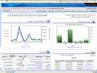

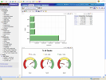
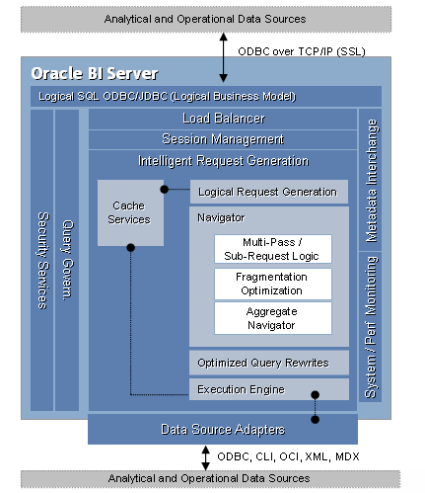

Oracle BI Server
功能强大的跨源可伸缩智能
简化的业务模型视图
高级计算和集成引擎
智能请求生成和优化的分布式数据访问
统一的元数据管理
面向服务的体系架构(SOA)
Oracle BI EE
表示服务
其它第 3 方工具
开放的 SQL 接口
简化的业务视图
统一的元数据
智能缓存
高级计算
聚合导航和创建
联合查询和集成
优化的 SQL / 功能传送
Oracle BI Server
原生 RDBMS
Oracle
SQL Server
DB2
Teradata
ODBC
多维
XMLA
Oracle OLAP Option
MS 分析服务
SAP BW
其它
XML、
Excel
文本
Notes:
The heart of Oracle BI EE is the Oracle BI Server. The BI Server is able to semantically integrate information from a variety of different sources into a single, simplified, enterprise-wide view of information. Through a combination of a distributed query engine and a logical, semantic model of the data, the BI Server enables you to represent multiple physical data sources as a single, simplified data structure to end user tools. This simplified view can then be queried by all end user tools through a simple SQL-based interface. So to end users the BI server looks like just another SQL data source.
With the BI Server, organizations can simultaneously access and derive insight from across multiple heterogeneous data sources, including:
Historical data sources in data warehouses
Real-time data stored in operational data sources and OLTP systems
Data stored in multi-dimensional sources such as SAP BW and the Oracle OLAP Option
Data stored in Files, Excel, XML
The BI Server also includes it’s own advanced calculation engine, so regardless of the calculation capabilities of the underlying data sources, organizations can get the intelligence they need. And calculations can be defined in the metadata that cut across data from multiple sources. For example, you may want to offer users a metric “% of quota” that compares closed revenue from a financial system with quota assignments in an Access database. This calculation would be defined in the BI server metadata and made available as a column that end users can select and embed into any analysis. So even complex calculations, like time-series calculations, can be defined and made available for end users, presented as a single element to select in the business model.

Slide 11
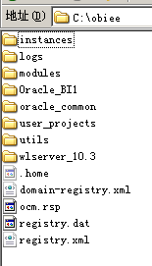
安装后的文件夹和文件
主要文件位置
  NQSConfig.INI ，Server 文件夹中的 Config 文件包括了 BI Server 的配置文件，配置了 BI Server 的主要参数，如使用哪一个 rpd 文件，cache 配置，日期格式配置等等，修改这个文件之后需要重启BI Server 的服务才能生效,(现给EM统一管理)； C:\obiee\instances\instance1\config\OracleBIServerComponent\coreapplication_obis1
  Repository 目录中包括了 BI Server 的 rpd 文件，也就是存放元数据的资料档案库文件； “\obiee\instances\instance1\bifoundation\OracleBIPresentationServicesComponent\coreapplication_obips1\catalog”
  Catalog目录：存放了BI Presentation 服务文件夹，其中包含了报表的定义等信息。每一个Catalog 对应于一个文件夹；“obiee\instances\instance1\bifoundation\OracleBIPresentationServicesComponent\coreapplication_obips1\catalog”
  NQQuery.log 。目录存放了日志文件，记录了查询语句。 C:\obiee\instances\instance1\bifoundation\OracleBIPresentationServicesComponent\coreapplication_obips1\catalog

Slide 12
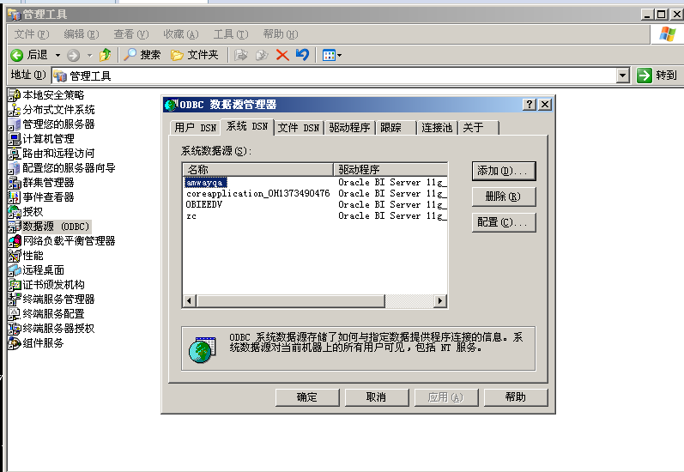
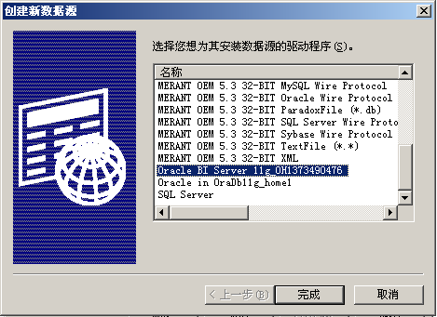
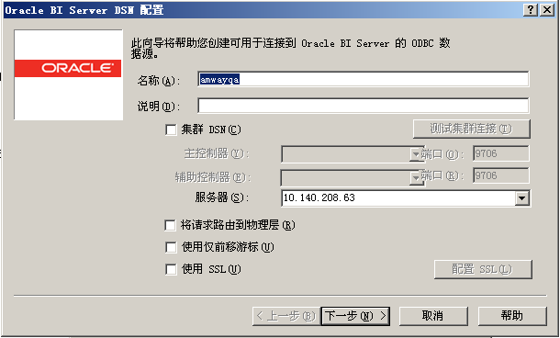
安装后的ODBC DSN

Slide 13
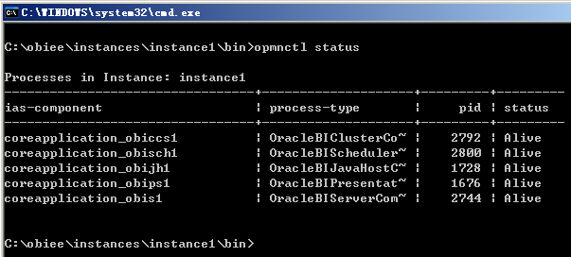
安装后的服务-opmm
Oracle BI Cluster Controller 是集群安装相关的服务，单实例安装不用启动；
Oracle BI Java Host 是前端展现中的 图表，PDF 打印等相关的功能用到的服务，如果要使用 Answer, Dashboard 等则需要启动；
Oracle BI Presentation Server 是前端展现所必需的服务如果要使用 Answer, Dashboard 等则需要启动；如果还需要使用图表或PDF打印等功能则必须还要启动Oracle BI Java Host；
Oracle BI Scheduler 是计划服务，Deliver 依赖于这个服务。安装之后还需要进行相关的配置才能启动这个服务。请参安装配置文档；
Oracle BI Server 是 Oracle BI Server 的服务。启动这个服务之后，biee 才能访问到数据，才能用 Administration Tool 进行在线的模型设计。这个服务提供了 ODBC 接口。
目录：C:\obiee\instances\instance1\bin
常用命令：
Opmnctl startall
Opmnctl stopall
Opmnctl status

Slide 14
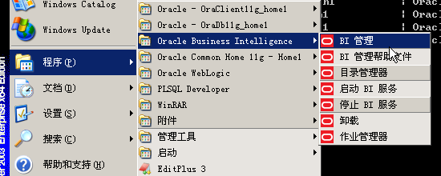
安装后的程序
BI管理(Administration Tools): BI Server 的管理工具，用来创建维护模型，并且能够管理安全，会话，变量等等。是用的最多的一个管理工具；这个工具可以编辑 rpd 文件也可以在线通过 ODBC 连接到 BI Server 进行管理；
目录管理器Catalog Manager: 目录（Catalog）管理工具。Catalog 中存放了报表等展现层的对象。可以通过 Catalog Manager 对报表进行复制，归档，多语言设计等管理工作；这个工具可以离线编辑 Catalog 文件夹，也可以在线连接到 BIEE 进行管理。在线连接的时候输入的 URL 的格式为： 如：http://biee.oracle.com:9704/analytics/saw.dll
启动BI服务:启动服务。
停止BI服务：停止服务。
作业管理器：作业管理工具，管理任务计划，例如发邮件等等。

Slide 15
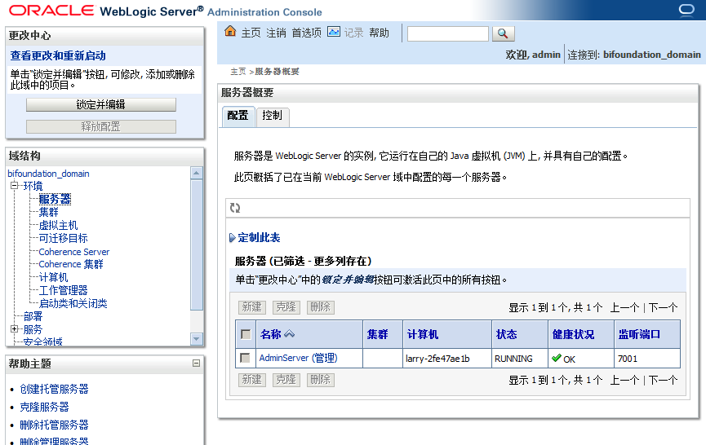
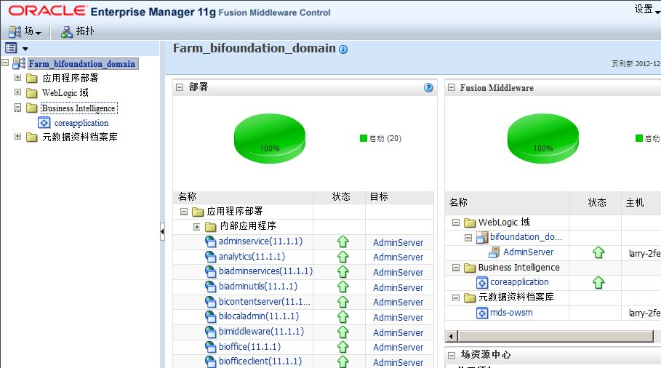
访问 BIEE
Oracle BI Interactive Dashboards ：可以进入到http://localhost:9704/analytics （端口或者为7001)
Console：weblogic控制台。 默认用户管理。
http://localhost:9704/console
EM：Oracle Enterprise Manager11g Fusion Middleware Control。 管理BIEE相关配置，部署等。
http://localhost:9704/em

Slide 16
目录
第二部分
报表开发

Slide 17
开发流程介绍
创建数据模型（客户端）
创建报表（IE上完成）
物理层
创建分析
创建查询条件
逻辑层
表示层
表示层

Slide 18
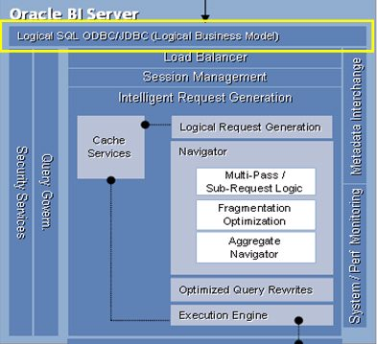
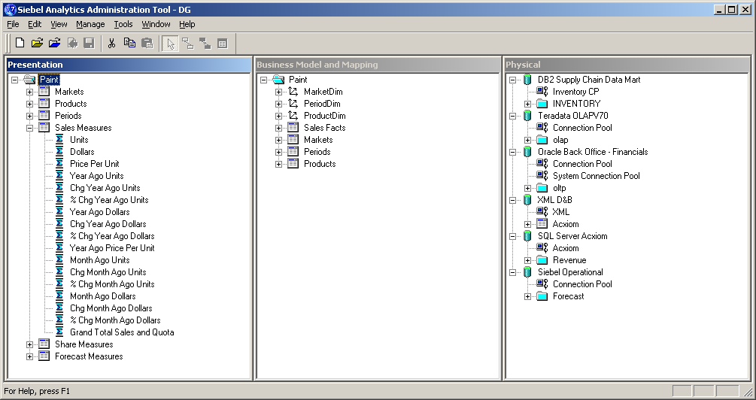


创建数据模型（客户端）
支持一致性、安全性、重用性、灵活性
表示层
基于角色的信息视图
用户角色、偏好
简化视图
逻辑SQL接口
语义对象层
维度
层次结构
度量
计算
聚合规则
时间序列
物理层
映射物理数据
连接
模式
一致的业务度量、指标、计算定义
一次建模，随处部署
跨任何数据源
Notes:
Speaker notes:
The Enterprise Information Model is designed to make query and reporting easier for end-users.
It includes a presentation layer, which provides role-based views of information for different types of users across your organization.
It includes a Semantic Object Layer, which provides consistent definitions of business measures, metrics and calculations.
And it includes a Physical Layer that maps your physical data sources into a single schema that can be accessed and leveraged across a wide variety of applications. This mapping can occur across a wide variety of data sources – relational multidimensional, etc.
This approach enables pervasive BI – while ensuring consistency, security, reuse and flexibility.

Slide 19
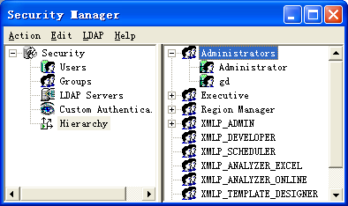
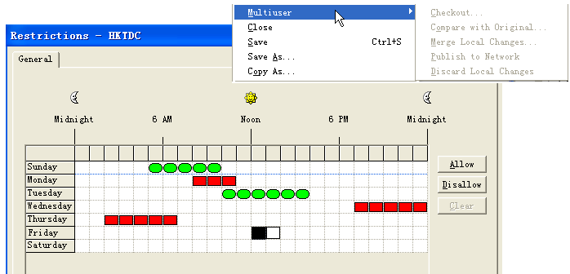
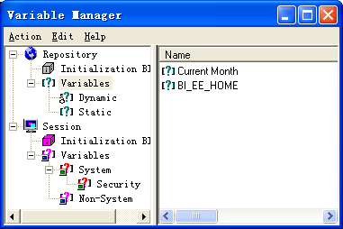
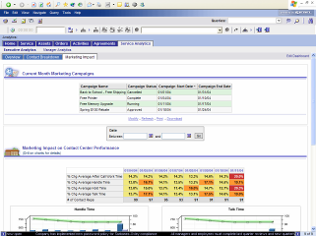
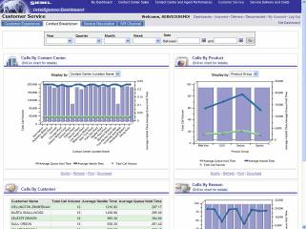
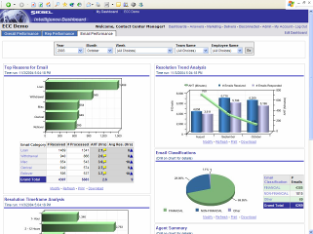
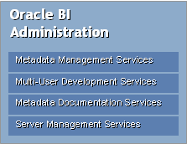
Oracle BI Administrator
统一的元数据管理
维护通用企业信息模型
  维度、度量、规则等
  用户权限管理
  Cache管理
  Session管理
  变量管理
  作业调度
脱机/联机开发模式
多人协同开发，版本控制
库表结构同步
Notes:
The heart of Oracle BI EE is the Oracle BI Server. The BI Server is able to semantically integrate information from a variety of different sources into a single, simplified, enterprise-wide view of information. Through a combination of a distributed query engine and a logical, semantic model of the data, the BI Server enables you to represent multiple physical data sources as a single, simplified data structure to end user tools. This simplified view can then be queried by all end user tools through a simple SQL-based interface. So to end users the BI server looks like just another SQL data source.
With the BI Server, organizations can simultaneously access and derive insight from across multiple heterogeneous data sources, including:
Historical data sources in data warehouses
Real-time data stored in operational data sources and OLTP systems
Data stored in multi-dimensional sources such as SAP BW and the Oracle OLAP Option
Data stored in Files, Excel, XML
The BI Server also includes it’s own advanced calculation engine, so regardless of the calculation capabilities of the underlying data sources, organizations can get the intelligence they need. And calculations can be defined in the metadata that cut across data from multiple sources. For example, you may want to offer users a metric “% of quota” that compares closed revenue from a financial system with quota assignments in an Access database. This calculation would be defined in the BI server metadata and made available as a column that end users can select and embed into any analysis. So even complex calculations, like time-series calculations, can be defined and made available for end users, presented as a single element to select in the business model.

Slide 20
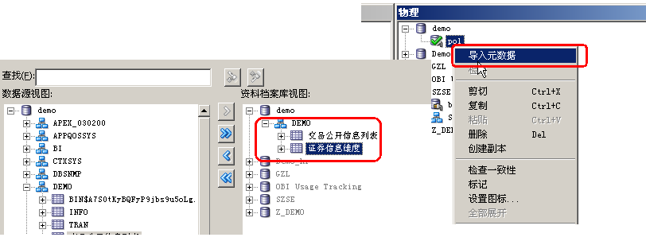
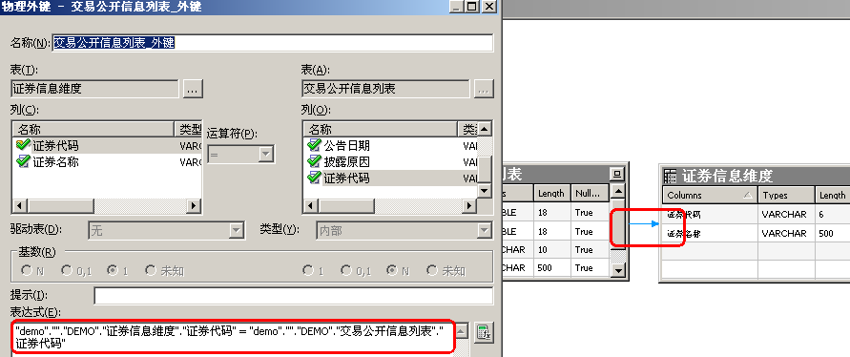
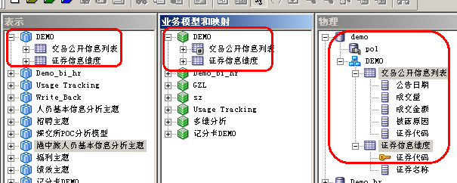
创建数据模型（RPD）

Slide 21
创建报表-创建分析
列（columns）的常规使用说明
  列属性 （column properties）
  编辑公式 （column formula）
  添加筛选器 （filter）
一些基本视图（views）的制作
  表（table）
  图表（chart）
  数据透视表 （pivot table）
  计量表 （gauge）
  列选择器 （column selector）

Slide 22
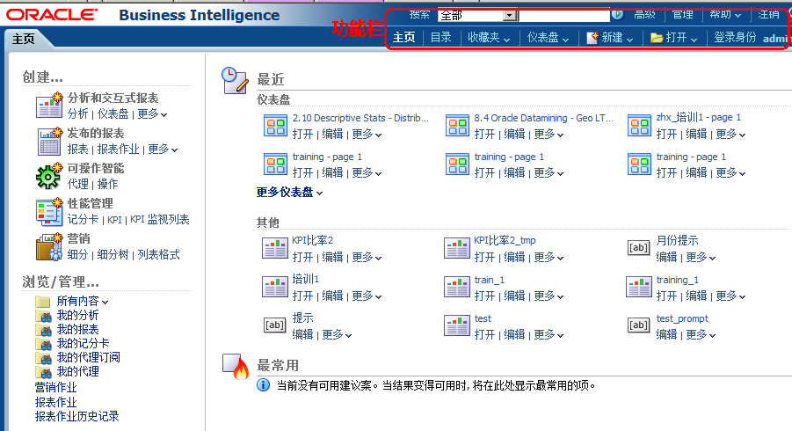
主区域

Slide 23
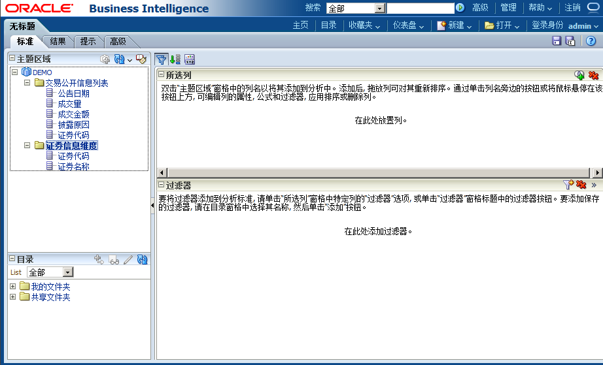
OBIEE Answers中各功能区使用说明
B
C
A

Slide 24
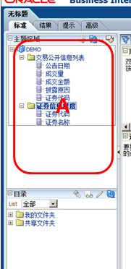
OBIEE Answers中各功能区使用说明
A区域是Admin Tool展现层
中的完全体现，所有的维度
表和事实表都在这里

Slide 25

OBIEE Answers中各功能区使用说明
B区域是查看报表的不同形式，“标准”是编辑模式，“结果”是查看报表结果，“提示”是给报表添加提示，“高级”可以看到报表所对应的XML和BIEE语法SQL语句等；

Slide 26
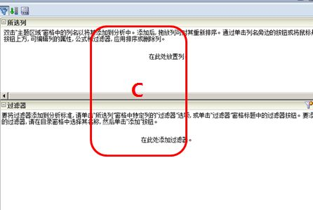
OBIEE Answers中各功能区使用说明
C区域是报表编辑的主区域，
报表中的行列和筛选器都在
这里显示供编辑。

Slide 27
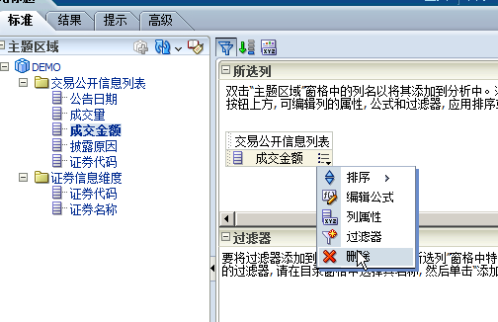
列设置
列设置
选择需要的维度和指标

Slide 28
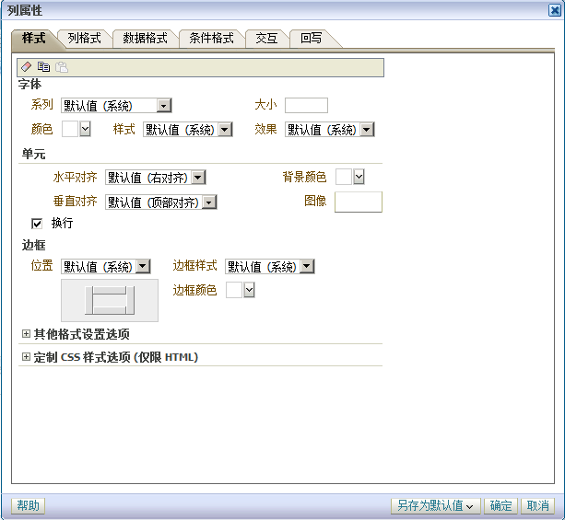
列的常规使用说明
列属性（column properties）
列属性的“样式”页主要是对该列的样式
进行设置，字体、单元格等等；“Column
Format”页设置列的标题，标题的交互作
用以及值得交互作用；“Data Format”设
置数据的格式，如你可以选择将数据设
置为HTML格式或者超链接；“Conditional
Format”可以设置当数据满足什么条件时
就使用特定的格式来显示，基本的预警就
是在这里添加的

Slide 29

列的常规使用说明
编辑公式（column formula）
这里可以对列进行公式编辑，
当列本身的数据无法满足要
求时，可以添加多个列进行
计算得到新的列。例如可以
使用“函数”来对Month字段进
行截断等运算。

Slide 30

列的常规使用说明
筛选器（filter）
筛选器是对数据显示的行数进
行显示的工具。如图，我们可以通过使用筛选器筛选数据。
运算符有多种，也可以在这里
应用各种变量，进行动态筛选。

Slide 31

视图
Answers提供了多种视图来展现数据：
1.Table（表）
2.Chart（图表）
3.Pivot table（数据透视表）
4.Gauge（计量表）
…

Slide 32


视图
表（table）
图中第一个红框是进入对整张报表进行
编辑。

Slide 33

视图
数据透视表（pivot table）

Slide 34





制作查询条件

Slide 35



制作一个简单的dashboard

Slide 36
目录
第三部分
Publisher

Slide 37

自助查询

Slide 38
BI Publisher
添加数据源
新建数据模型
创建报表

Slide 39


添加数据源
jdbc:oracle:thin:@localhost:1521:orcl

Slide 40


新建数据模型

Slide 41

创建报表

Slide 42
目录
第四部分
其他功能

Slide 43
其他功能
检索
地图功能
平衡记分卡
回写
发送邮件
运维管理

Slide 44

数据检索

Slide 45


平衡记分卡

Slide 46



地图功能

Slide 47



Delivers 代理

Slide 48

运维管理-审计日志Usage Tracking

Slide 49


运维管理-增量上线

Slide 50

SQL直接查询
创建数据库连接
(DESCRIPTION = (ADDRESS_LIST = (ADDRESS = (PROTOCOL = TCP)(HOST = localhost)(PORT = 1521)))(CONNECT_DATA = (SERVER = DEDICATED)(SERVICE_NAME = orcl)))

Slide 51

SQL直接查询
创建表格
select a."公告日期",a."证券代码",b."证券名称",a."成交金额(元)",a."成交量(股/份)",a."披露原因" from "交易公开信息列表" a, "证券信息维度" b
where a."证券代码" = b."证券代码"

Slide 52
成就客户，创造价值
Customers’ Success, Our achievement
注重品质 勇于创新 诚信责任 共赢发展
您可信赖的BI解决方案及服务提供商
Thank you

